Slide 1
Human resources slide 1
BUILDING TRADES
EDUCATION SERVICES
Getting started after receiving your book kit

Slide 2
Human resources slide 2
THE FOUR STEP PROCESS
Over the course of this presentation, you will learn how to:
Get organized: separate study guide materials from reference book materials.
Tab both your Business & Finance and Trade study guides.
Tab your reference books.
Highlight the Table of Contents and Index for each reference book.
Highlight the text of your reference books.

Slide 3
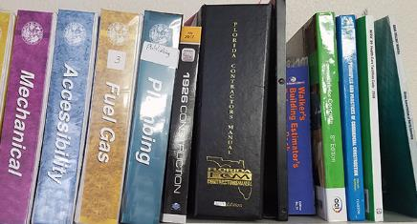
Human resources slide 4
STEP 1:
GET ORGANIZED
STUDY GUIDE TABS
REFERENCE BOOK TABS
Included in your book kit:
Study Guides (Trade and/or Business)
Reference Books (Textbooks)
Small tabs for your Study Guides
Large tabs for your Reference Books
LOCATE YOUR TABS
LINE UP YOUR TEXTBOOKS
2 different types:
The small tabs inside the front cover of your study guides are only used for the study guides. Your reference books will use the larger tabs that are packaged separately.
Take out all your reference books and separate them from the rest of your materials.
TAKE OUT AND OPEN YOUR SEALED STUDY GUIDES:
START TABBING YOUR STUDY GUIDES
Black binding = Business
Red binding = Trade
Go to the next slide to learn this step.

Slide 4
Human resources slide 3
STEP 2:
TABBING
YOUR
STUDY
GUIDE
WRITE ON YOUR TABS
For this Table of Contents we would need 6 tabs. Write the chapter number on each tab.
Table of Contents:
Chapter 1: Licensing……………………….3
PLACE YOUR TABS
Chapter 2: Lien Laws ……………………15
When opening your Study Guide you will see that all odd-numbered pages are on the right side, while even numbers are on the left.
The tabs for each chapter should be placed on the page before the chapter begins. When you pull open the tab, you will on the first page of that chapter.
For example: Chapter 6 starts on page 67. You would place the tab for that chapter on page 65. Go to the next slide to see a video example.
Chapter 3: Accounting………………….25
Using the small tabs that were sealed inside the study guides, let’s look at an example to demonstrate how to tab your study guides.
Chapter 4: Risk Management……….37
Chapter 5: Safety………………………….55
Chapter 6: Labor Laws………………….67
Let’s pretend your study guide Table of Contents looks like this:

Slide 5
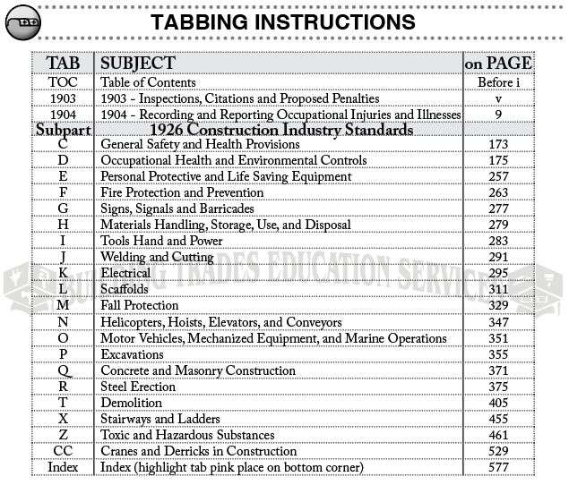
Human resources slide 5
TABBING YOUR REFERENCE BOOKS
REFERENCE BOOK TABS
Once your Study Guides are tabbed, move on to your Reference Books. You will need 3 items:
Locate your Reference Book tabs.
Open your Study Guide (Business or Trade) and flip through the first few pages until you find the Table of Contents. Starting from the top, look through the Table of Contents for the first Reference Book listed. Flip to the page where that Book section begins in the Study Guide.
Tab your Reference Book according to the instructions in the Study Guide. If it’s a codebook (Florida Building Codebooks), it comes with pre-printed tabs. There will not be instructions for pre-printed tabs as they are self-explanatory.
TABBING INSTRUCTIONS
REFERENCE BOOKS

Slide 6
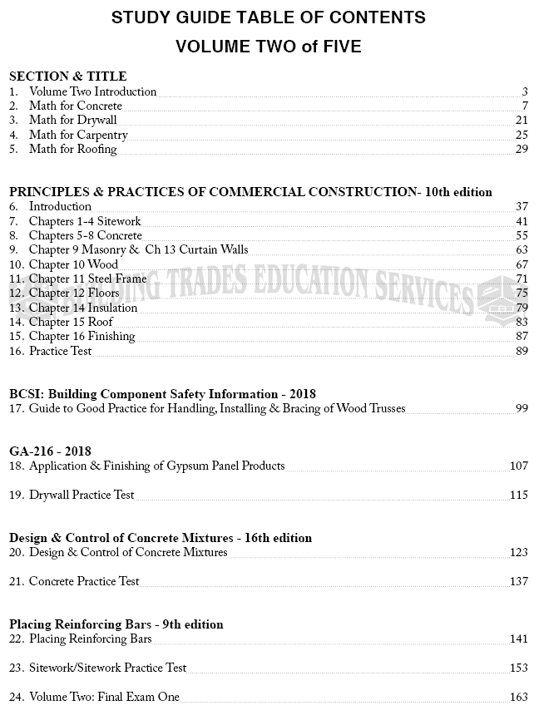
Human resources slide 6
EXAMPLE: TABBING A REFERENCE BOOK PART 1
Almost every textbook/reference book in your book kit will have tabbing instructions in the study guide. Here’s another example of the process:
Look at this Table of Contents from the General Contractor study guide.
Notice that the first reference book listed is “Principles & Practices of Commercial Construction,” beginning on page 37. To find the tabbing instructions for this book, you would flip to page 37 and look through the next couple of pages. Tabbing instructions always come before highlighting instructions. If the section begins with only highlighting instructions, that means the reference book doesn’t need to be tabbed.
Most books do need to be tabbed, and you’ll see the instructions on the 2nd or 3rd page of the chapter, between the chapter’s title page and the highlighting instructions.
The next book would be “BCSI: Building Component Safety Information,” beginning on page 99. After that, you’d tab the “GA-216 Gypsum” reference book, starting on page 107. Keep doing this until ALL your reference books have been tabbed according to our instructions.
Let’s move on to Part 2.

Slide 7
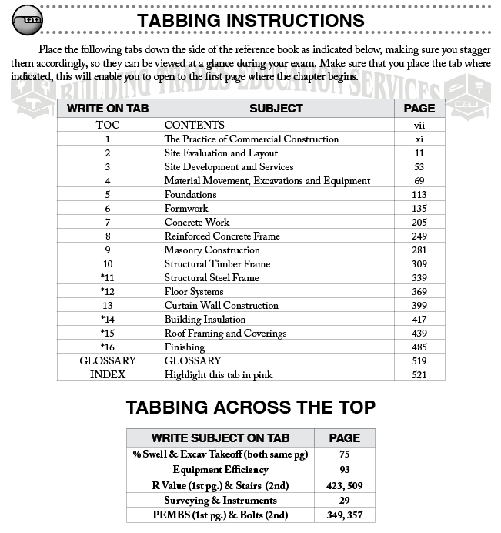
Human resources slide 8
EXAMPLE: TABBING A REFERENCE BOOK PART 2
This is what you’re looking for:
Now that you know how to find the tabbing instructions, let’s look at the actual process.
On the previous slide we showed that the first reference book in that Table of Contents was “Principles and Practices of Commercial Construction.” On the right side of this slide are the tabbing instructions found on page 38, the page right after the Introduction to the chapter. When you see this table, you know you’re in the right place.
The top table has 3 columns: the left column is what you write on the tab, and the right column is the number of the page where the tab should be placed. The middle column is simply there to tell you the subject of the chapter or section and doesn’t require any action on your part. The table on the bottom under “Tabbing Across the Top” lists tabs that should be placed along the top of your book from left to right, instead of down the side.

Slide 8
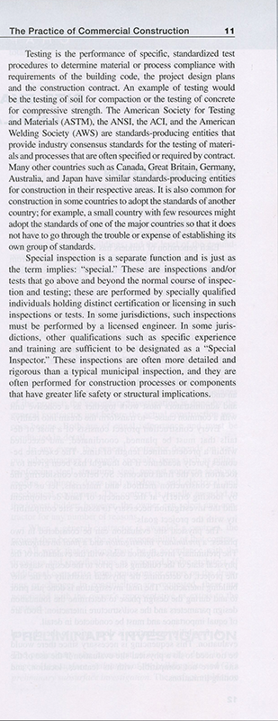
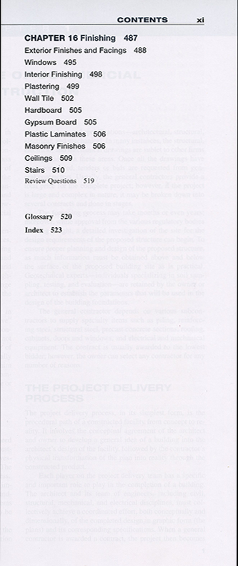
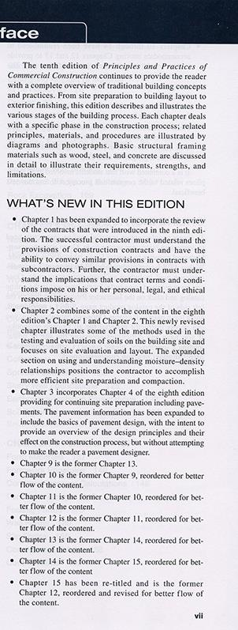
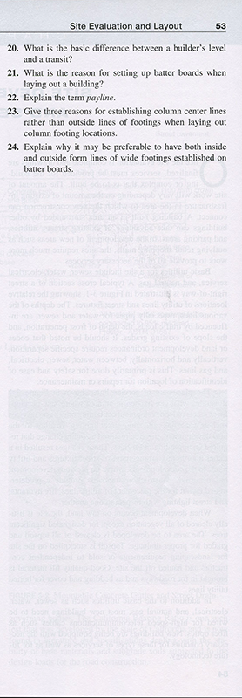
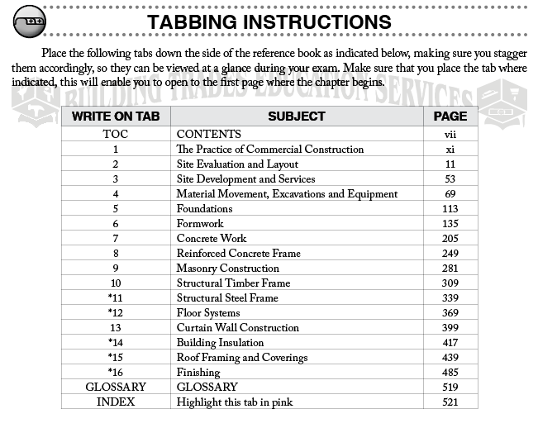
Human resources slide 11
EXAMPLE: TABBING A REFERENCE BOOK PART 3
Here’s a visual example of tabbing your reference book:

Slide 9
Human resources slide 9
HIGHLIGHTING YOUR REFERENCE BOOKS
Look for these identifiers in the study guides:
Table of Contents, Index, Guts
Not all your books will have highlighting instructions for the Table of Contents, Index, or both.
Table of Contents
After you’ve tabbed all your reference books, start highlighting the Table of Contents and Index for each book and then move on to the next. When you’ve finished that step, start highlighting the actual body text.
The highlighting instructions are found after the tabbing instructions in the study guide and are easy to follow:
(p) = pink highlighter
(y) = yellow highlighter
(o) = orange highlighter
If you don’t see headers for highlighting the Table of Contents or Index of your reference book in the study guides, you’ll most likely only need to highlight the text.
Index
OR
For a more detailed guide on how to highlight your books, check out our YouTube video on the same page you found this presentation.
Body Text/Guts
www.buildingtradeeducation.com

Slide 10
Human resources slide 7
PRESSED FOR TIME? PRIORTIZE:
10%
45%
15%
30%
Tabbing Your Study Guides
Tabbing Your Reference Books
Highlighting the Table of Contents
and Indices for Reference Books
Highlighting the Body/Guts
of Your Reference Books
Least important, but still helpful.
Most important for navigation.
Important for identifying commonly used chapters and keywords.
Important for locating answers.

Slide 11
Human resources slide 10
Thank You
For any questions, don’t hesitate to give us a call at (800) 832-2496.

